Slide 1



PBLMK232-54.
Mini CNC Milling using Integrated Servo Motor.

Slide 2
Team Member:
Budiman Zahri (4212111011)
Ilham Zulfadillah (4212011015)
Rocky S (4212111036)
Galuh Candra Kirana (4212111046)
Eldio Utama (4212111063)
Muhammad Fatzri Sabila (4212111064)
Mohammad Ikhsan (4212131005)

Slide 3
What is Mini CNC Milling using Integrated Servo Motor.

Slide 4
Table of Content
Work Breakdown Structure
Diagram Blok System
Design System
Final Result
Obstacles
Conclusion
Suggestion

Slide 5
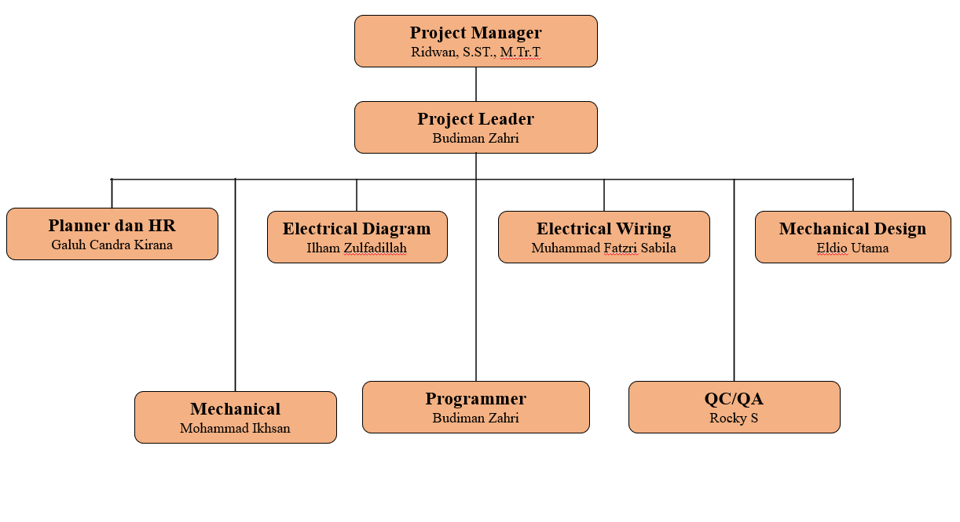
Work Breakdown Structure

Slide 6
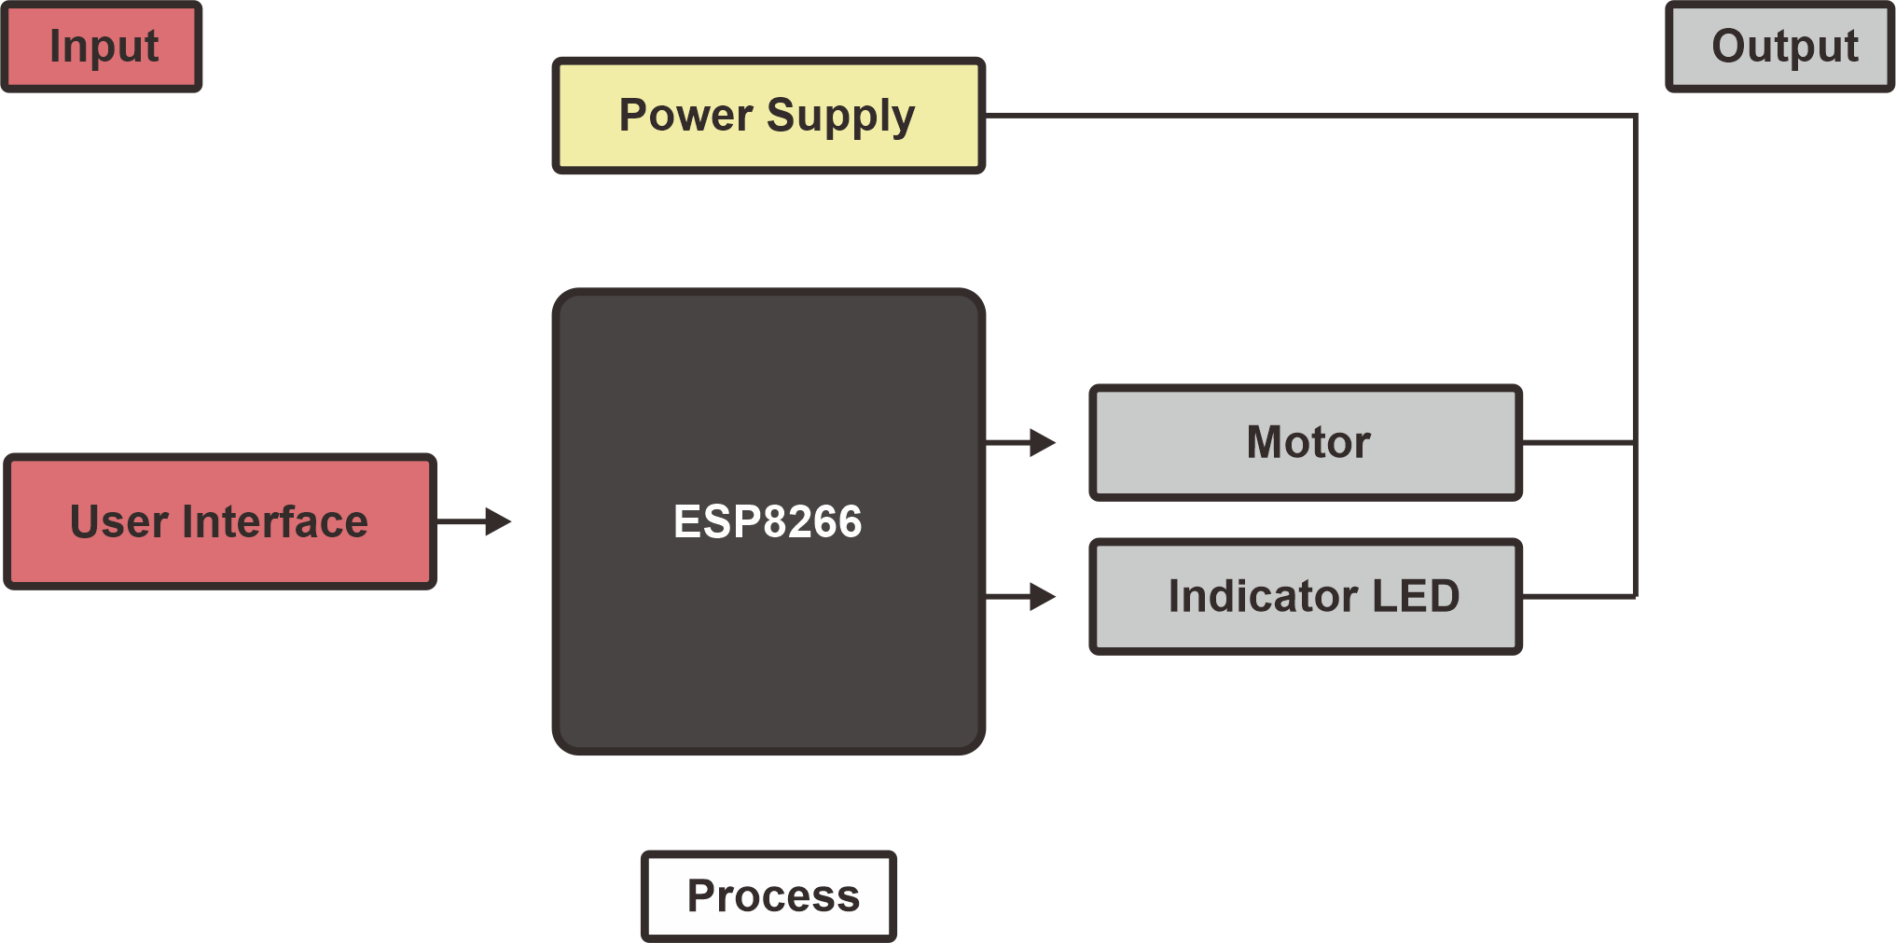
Diagram Blok System

Slide 7
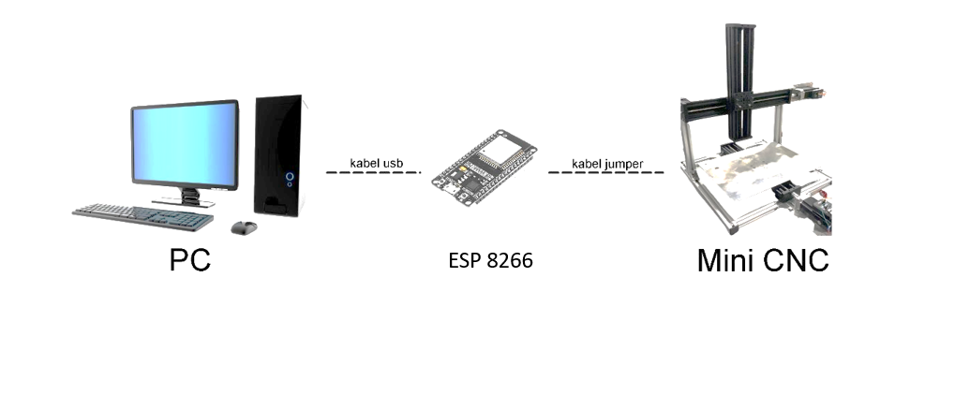
Design System

Slide 8
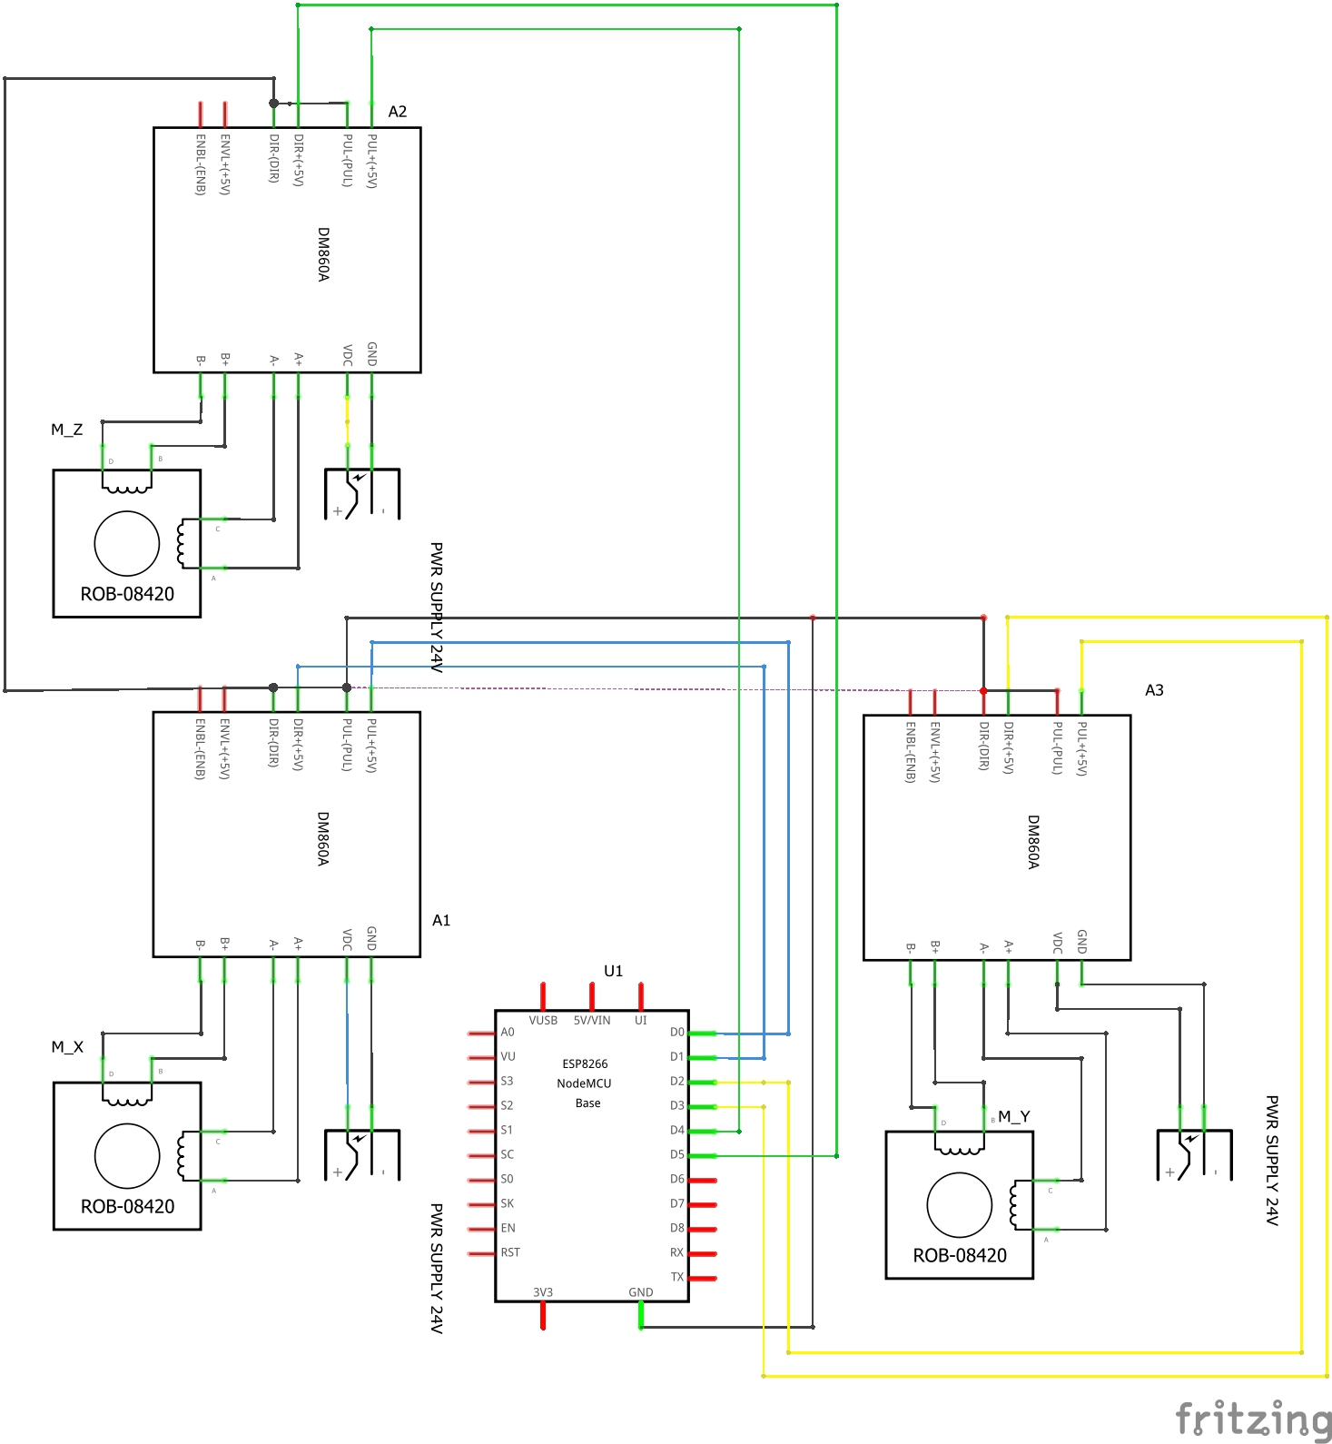
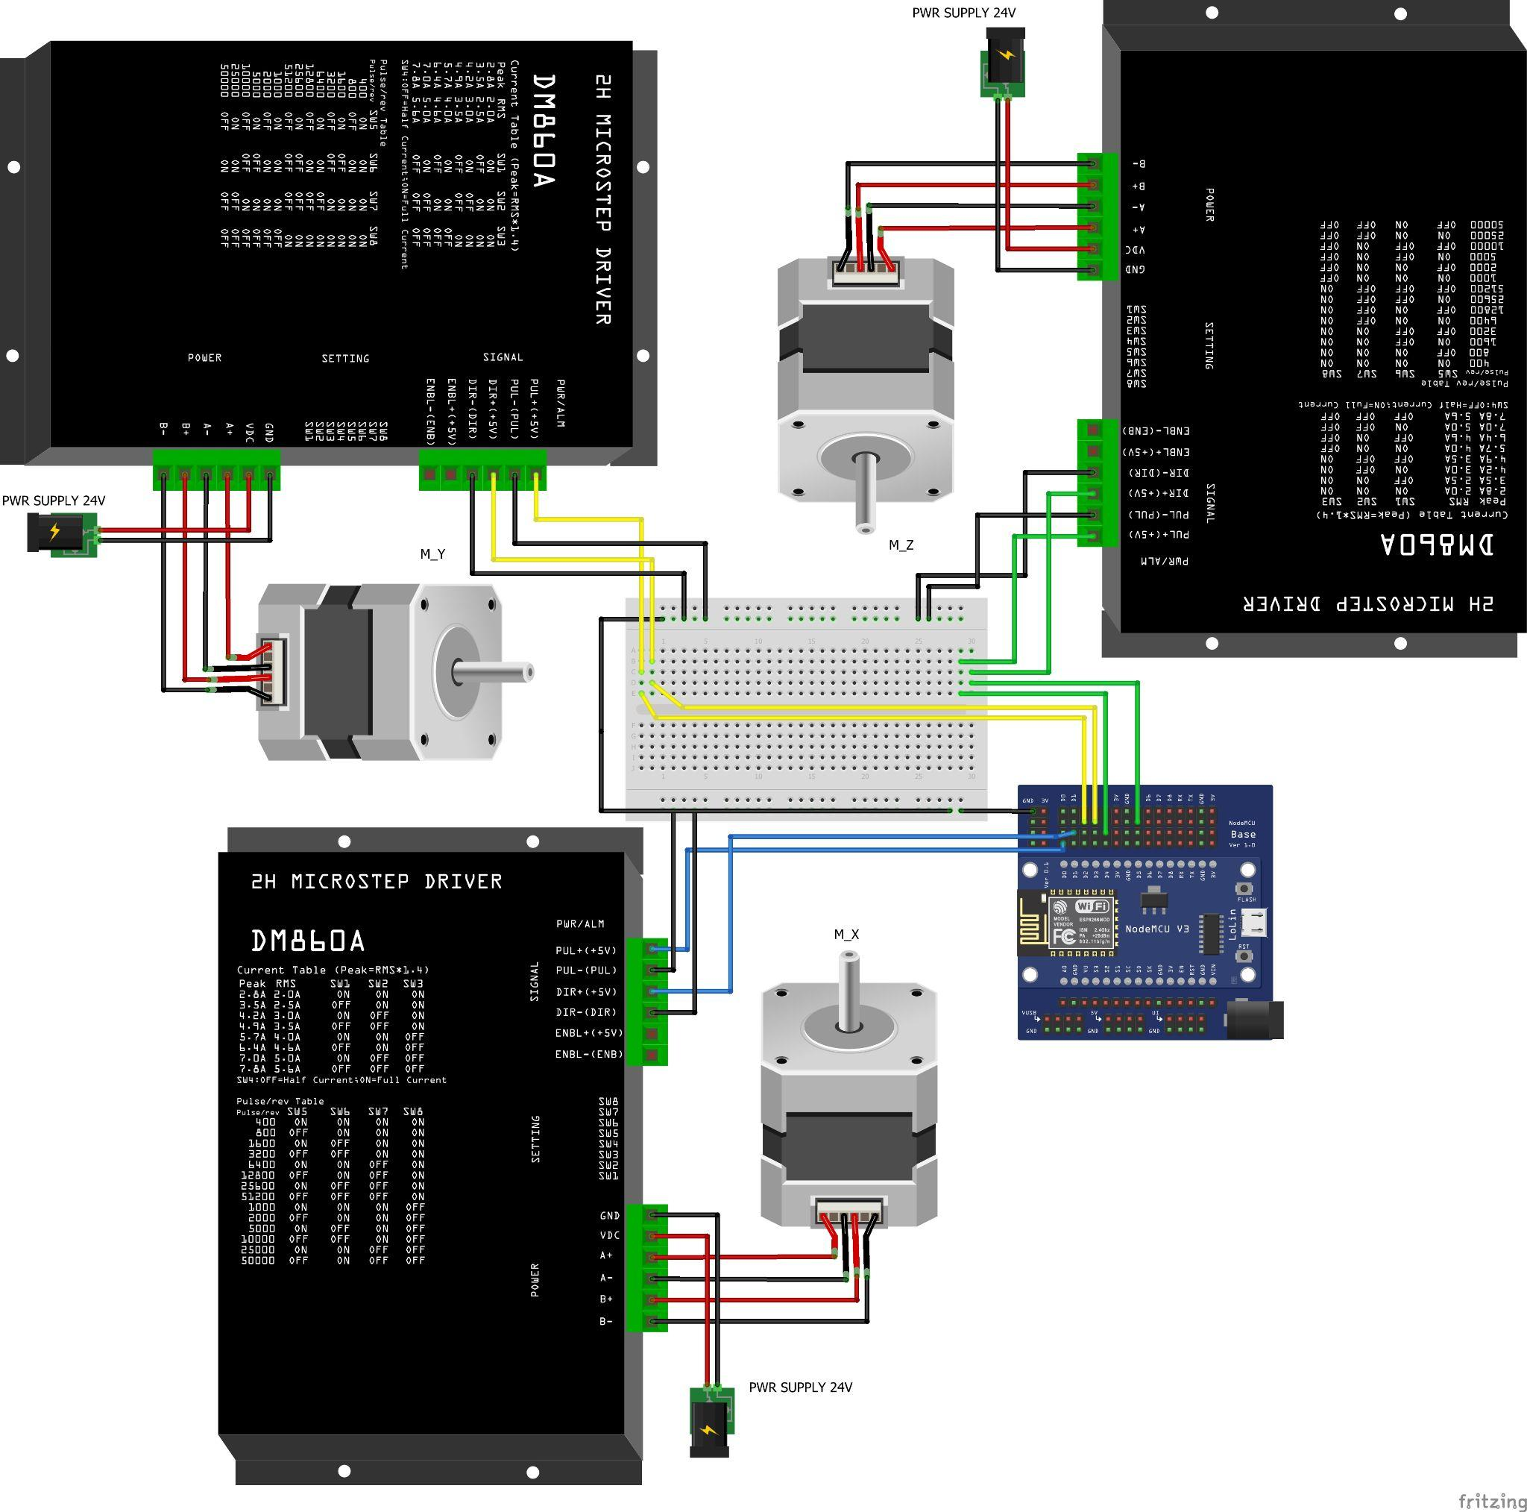
Final Result
Diagram Wiring Elektrikal

Slide 9
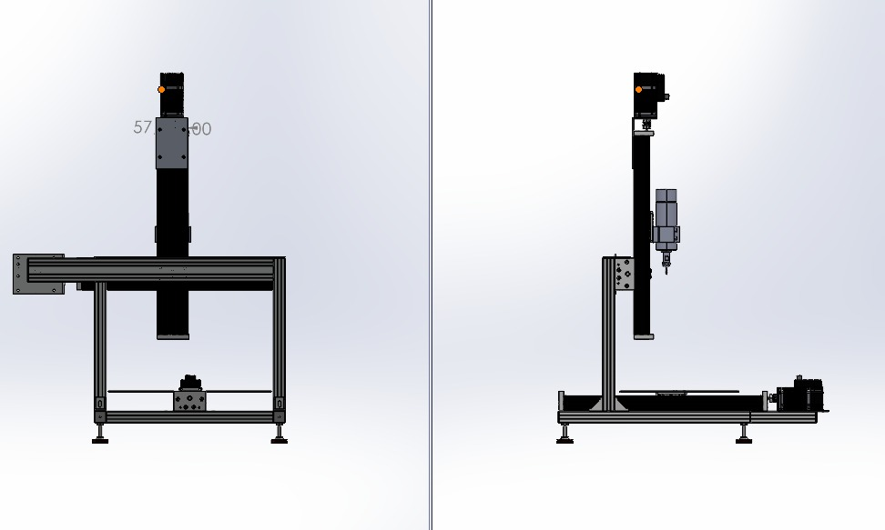
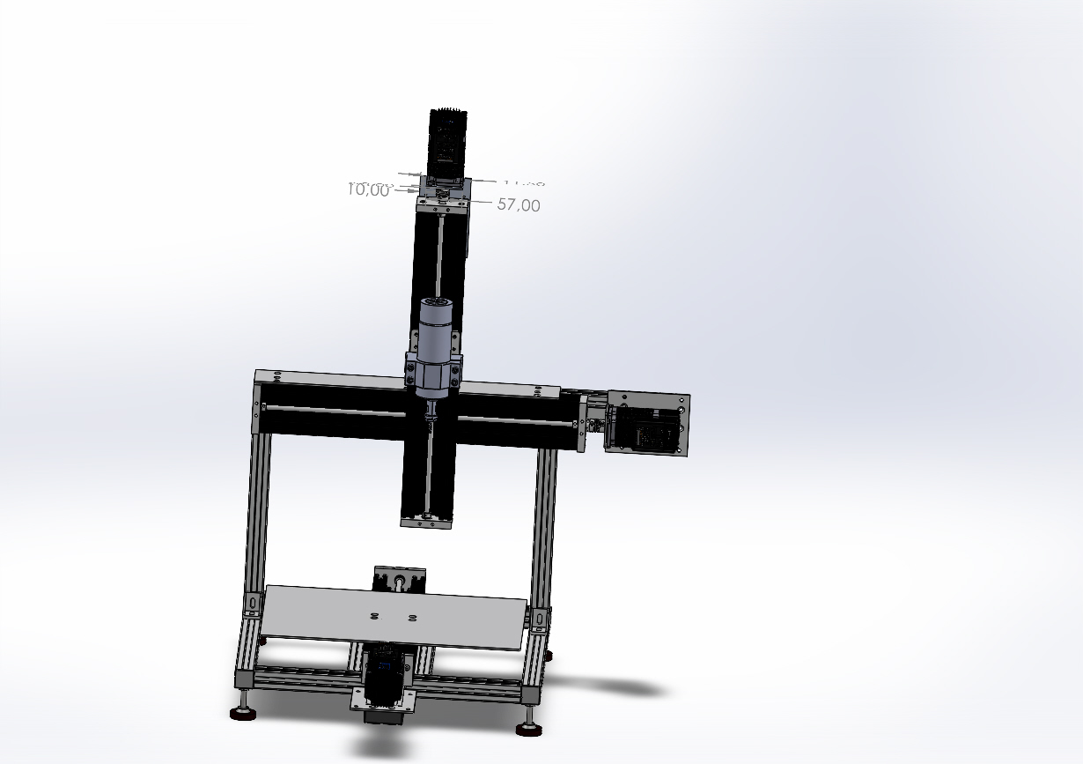
Final Result
Mechanical Design

Slide 10
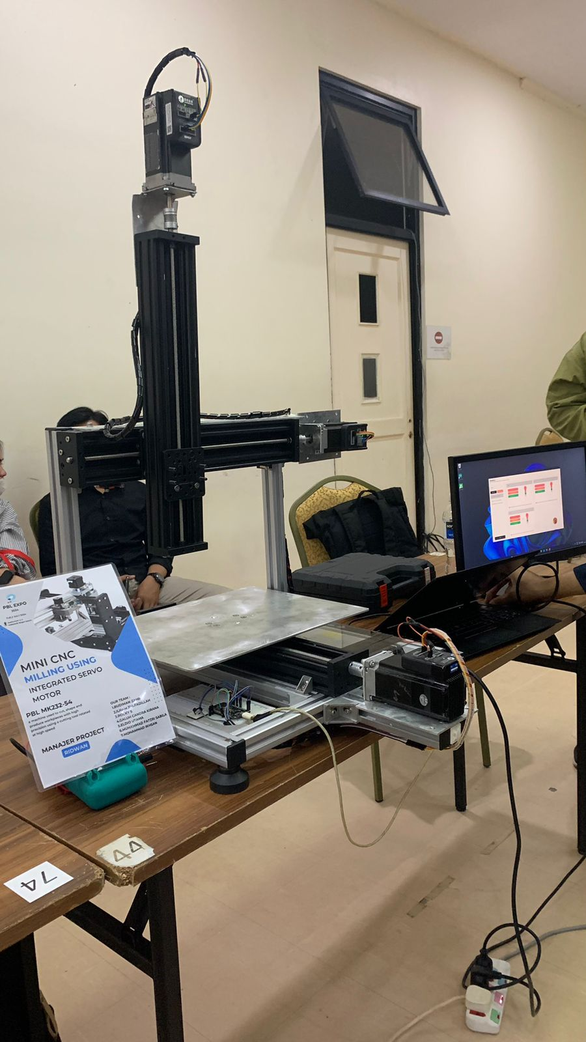
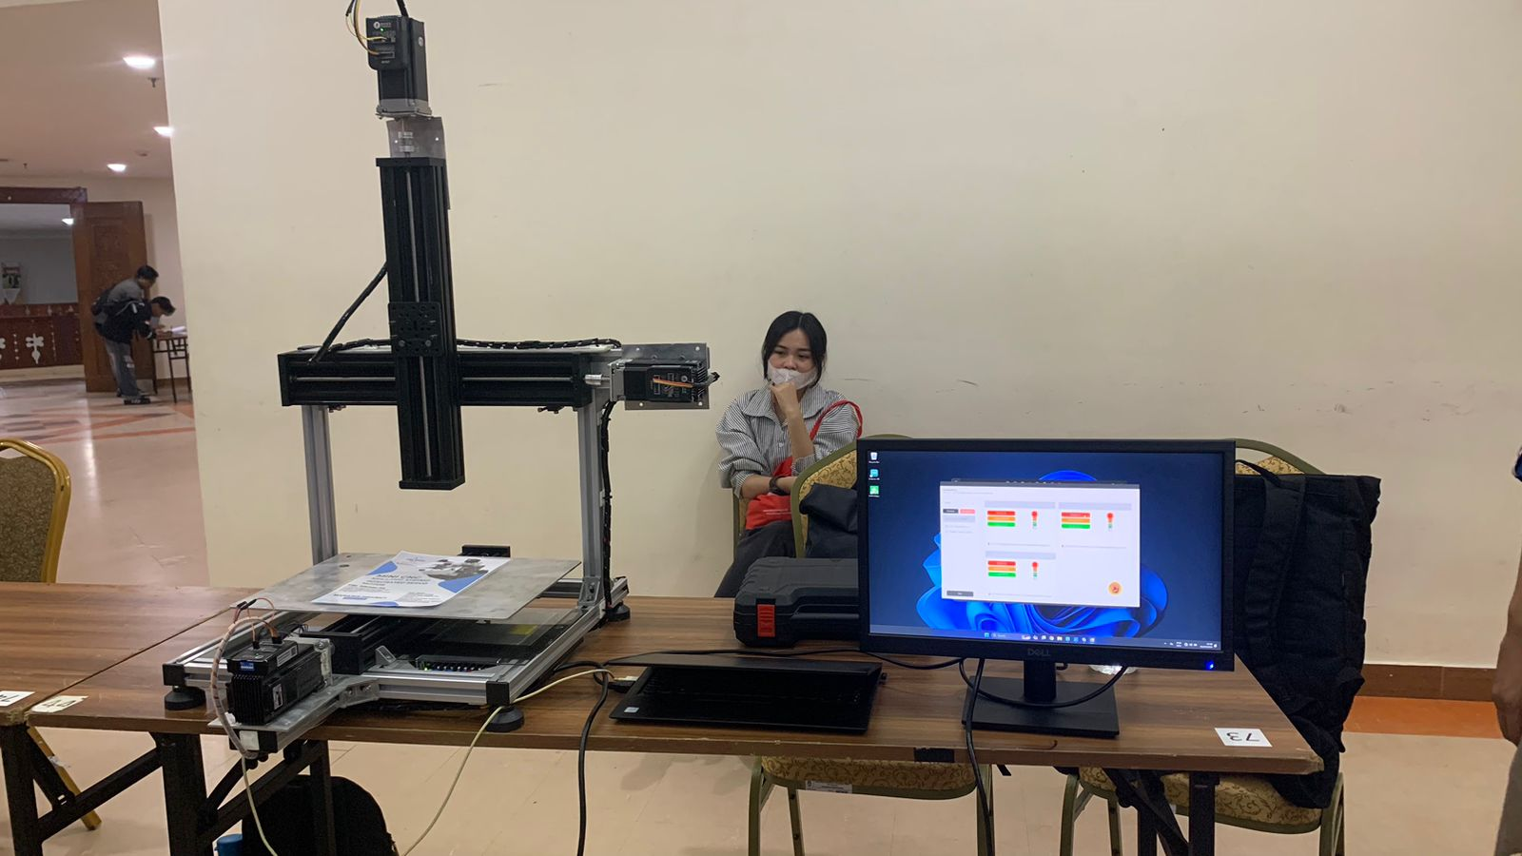
Final Result
Photo of Mini CNC Milling Using Integrated Servo Motor

Slide 11
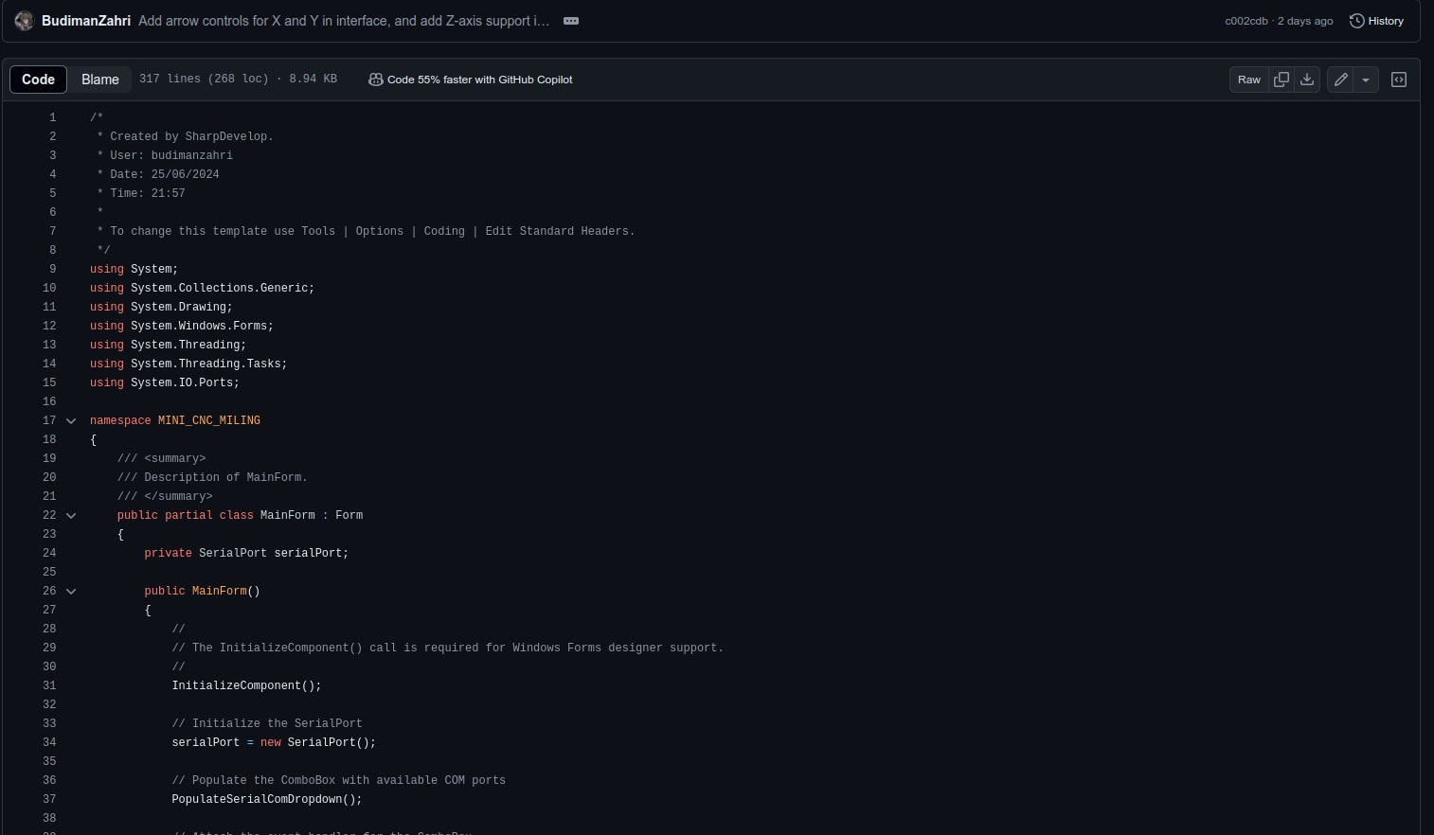
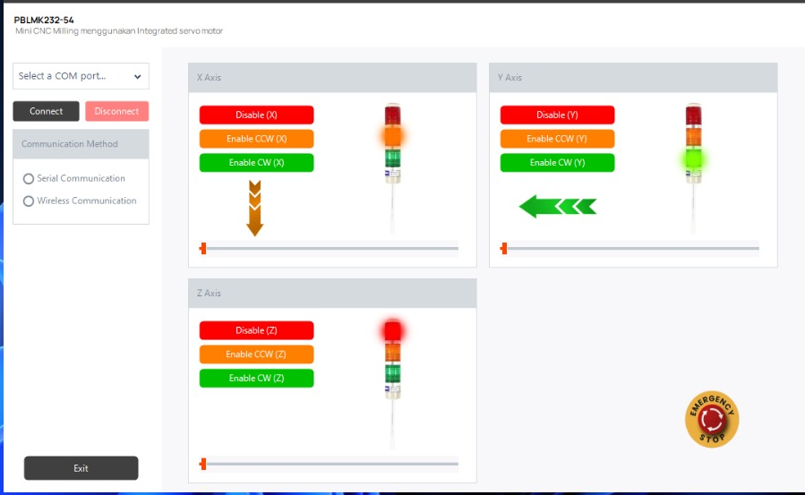
Final Result
Program
User Interface

Slide 12
Final Result
https://drive.google.com/file/d/1ALoPDWf_gHHZprPM6N0zbRCpCHwBUnMi/view?usp=sharing
Video Demonstration

Slide 13
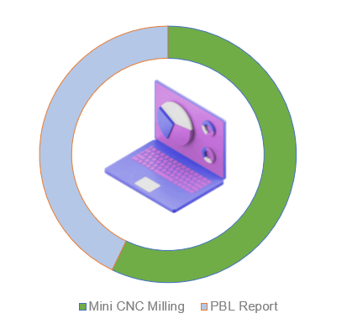
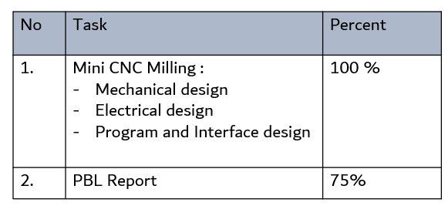
Final Result
https://docs.google.com/spreadsheets/d/1h8bO2YwVi7uHkURxOVsRIHrSXRGba9t4V_uWBS5vvno/edit?usp=sharing
Percentage of Attainment

Slide 14
Obstacles
Delays in the delivery of Consumables (BHP) became a obstacle in this project, forcing the team to improvise using available components.

Slide 15
Conclusion
The project successfully developed a mini CNC milling machine with integrated servo motors by constructing and fixing mechanical components for the Z and Y axes, creating 3D designs and schematic wiring, implementing wiring and programming for X, Y, and Z control, and create final report and QC/QA documentation for checklist.

Slide 16
Suggestion
All of team member can carry out the project
Make estimated duration of submitted the list BHP

Slide 17
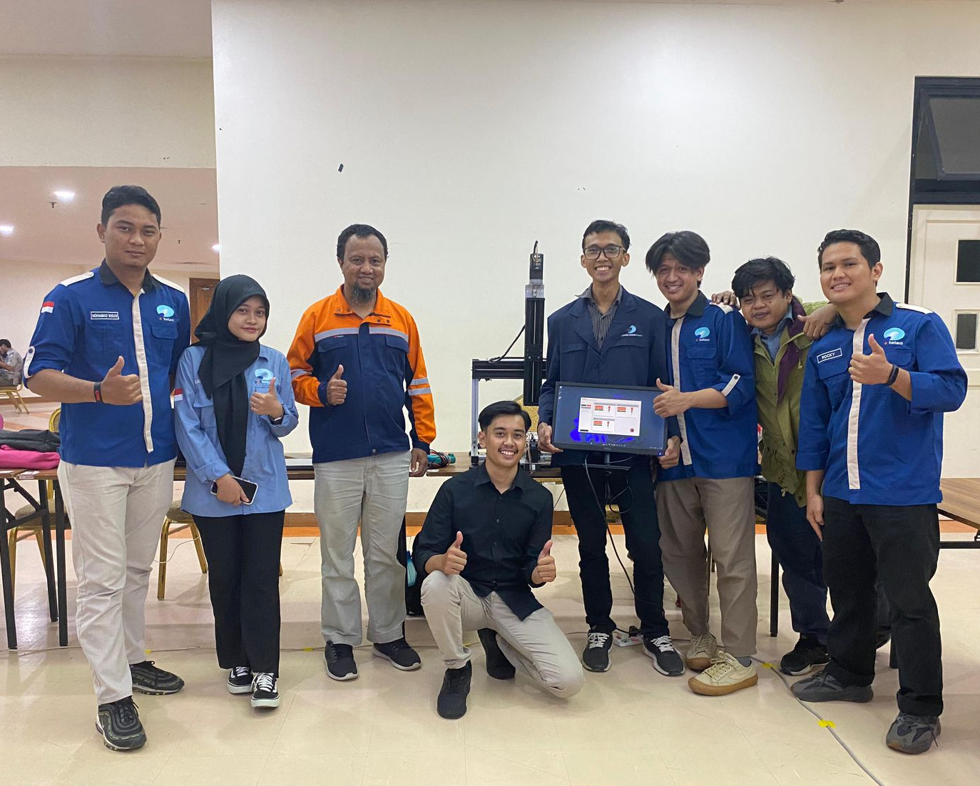
Thank You!

